Slide 1
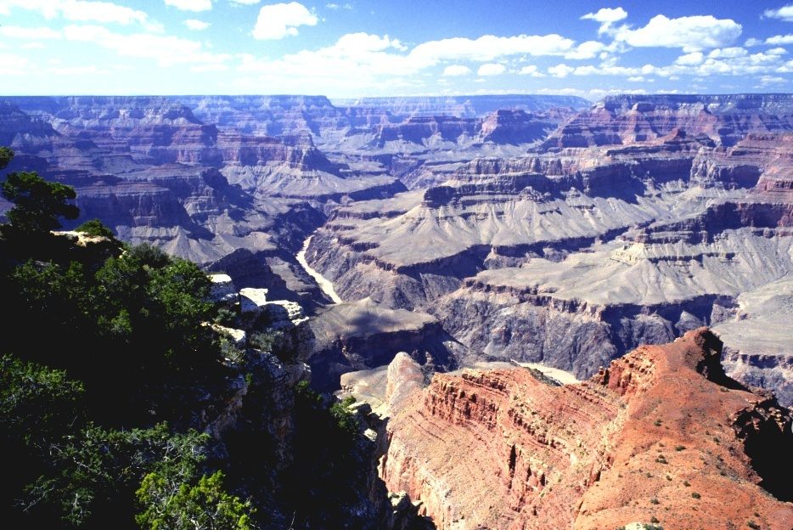
Notes:
Although every stage of the Wilson Cycle is represented in the almost 2 billion-year geologic history of the Grand Canyon, they are not preserved equally well. The time period during which this region was a Divergent Continental Margin is by far the best preserved, and is recorded in the beautiful horizontal strata for which the park is famous. Our examination of the canyon will cover its entire history, but emphasize the Paleozoic Period when it was a DCM.

Slide 2
Geologic Overview
History
Notes:
Before we tell the grand story of the canyon’s history, I want to make sure you understand the basics of how this incredible book was opened and shaped into the awesome sight we see today.

Slide 3
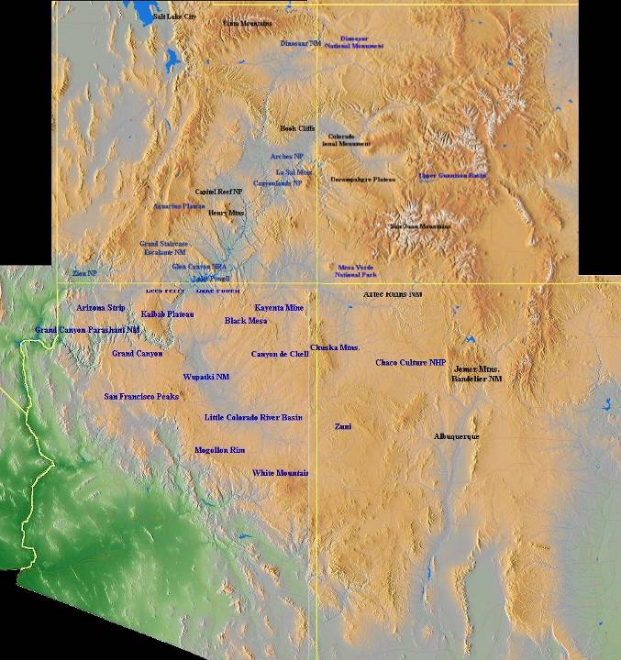
Grand Canyon
Notes:
The Grand Canyon …

Slide 4
Notes:
… and several other popular National Parks ….

Slide 5
Colorado Plateau
Notes:
… are located within an elevated, relatively flat physiographic province, crudely centered on the four corners region, known as the Colorado Plateau.

Slide 6
Colorado Plateau is defined by what did not happen to it.
Colorado Plateau
Notes:
Geologically, the Colorado Plateau is perhaps best defined by what did not happen to it. While the Rocky Mountains to the east and the Basin and Range to the west and south were being thrust, stretched, and fractured into existence, the Colorado Plateau remained structurally intact.

Slide 7
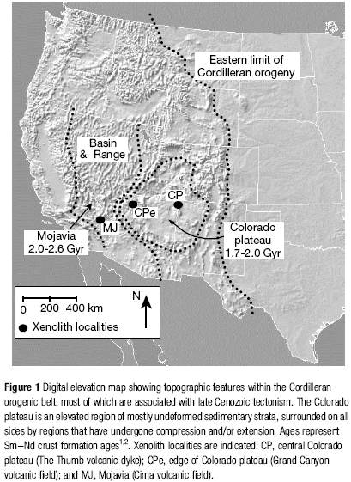
Underlain by relatively thick “depleted” lithosphere.
Notes:
Recent research has found evidence that the Colorado Plateau has remained an island of tectonic quiescence because unlike neighboring areas it is underlain by a relatively a thick lithosphere “depleted” in iron and heat. Apparently both were extracted early in the region’s history, roughly 1.6 - 2 billion years ago, by partial melting and eruption of magma to the surface. The “depleted” mantle persists as a thick, stiff, thermal boundary layer between the crust and the convecting mantle below. By contrast, the southern Basin and Range province is underlain by “fertile” (wet and iron rich) relatively thin lithospheric mantle.

Slide 8
Green River
Colorado River
San Juan River
Little Colorado River
Notes:
Despite the region’s relative aridity, the plateau is highly dissected by water-carved canyons. This apparent paradox is resolved by noting that several major rivers flow across it that have their headwaters in the Rocky Mountains where precipitation is much greater. Stream flow in the Colorado Plateau is therefore largely “imported”, ….

Slide 9
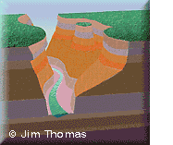
No erosion
All erosion
Notes:
… thereby confining virtually all erosion to stream channels and creating abrupt transitions from plateau to canyon. Note that deep stream erosion makes the canyon slopes gravitationally unstable and eventually mass wasting events widen the canyon significantly .

Slide 10
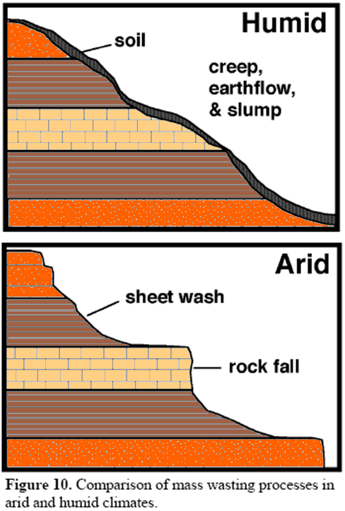
Notes:
In a humid climate, weathering and mass wasting processes produce a smooth, rounded topography covered by a thick soil layer regardless of the rock types below. In the arid climate of the Colorado Plateau, topography becomes step-like where rocks of varying erosion resistance occur.

Slide 11
limestone
shale
sandstone
Notes:
Cliffs tend to form on limestone and sandstone which are relatively resistant to erosion in arid regions, whereas gentler slopes form on shale which is highly erodible.

Slide 12
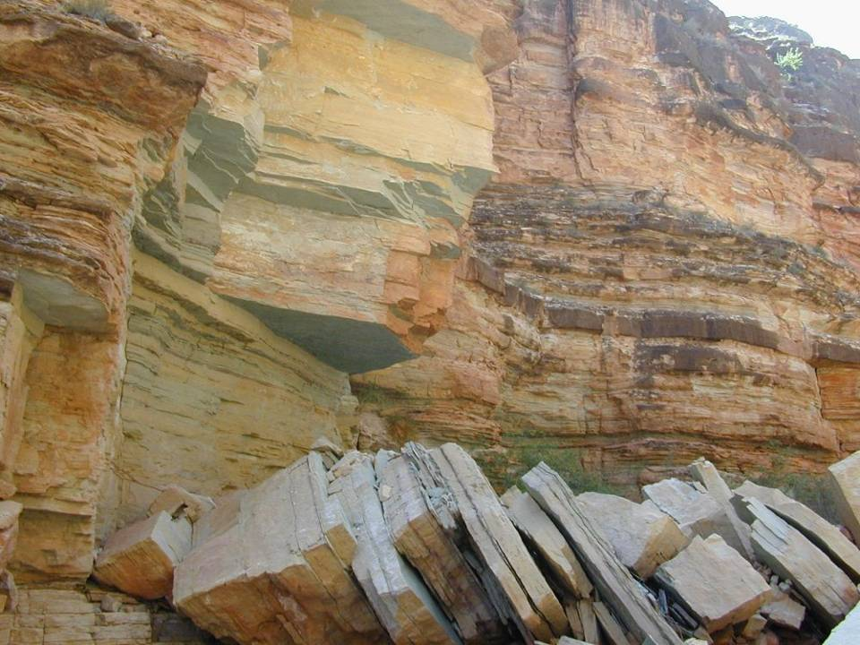
joint surface
Notes:
For sandstone and limestone, rock falls are the dominant type of mass wasting. They typically occur along vertical joint surfaces, thereby leading to cliff formation.

Slide 13
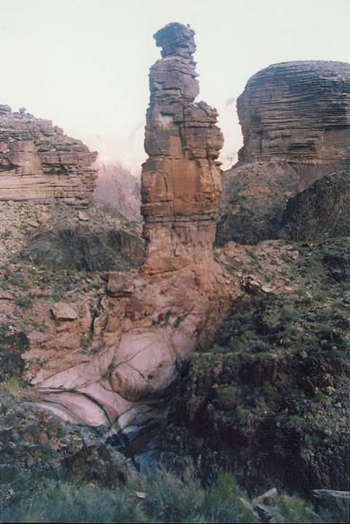
“The Monument”
Notes:
In a few places repeated rock falls have left spectacular pinnacles.

Slide 14
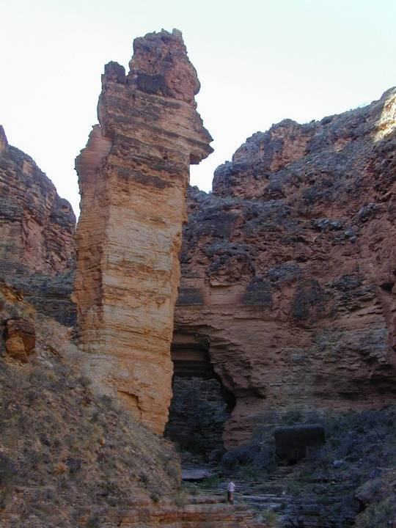
Pinnacle below Royal Arch
Notes:
It won’t be long before these topple as well.

Slide 15
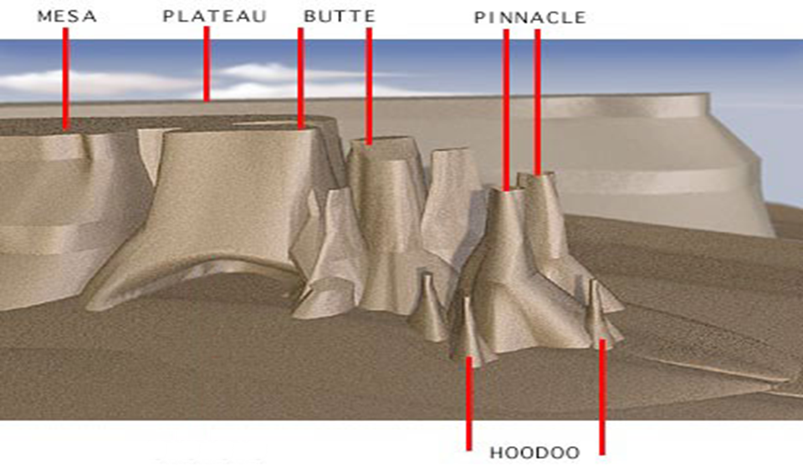
Notes:
Erosion and mass wasting are focused along the canyons and joints that breach the layer of erosion-resistant rock usually capping the plateau. A series of progressively smaller, steep-sided, flat-topped landforms develop, most of which are capped by ever smaller remnants of the former plateau. The distinctions between these landforms are mostly a matter of relative size. From largest to smallest the sequence is: plateau, mesa, butte, pinnacle, hoodoo. Except for the plateau, all of these are isolated landforms.

Slide 16
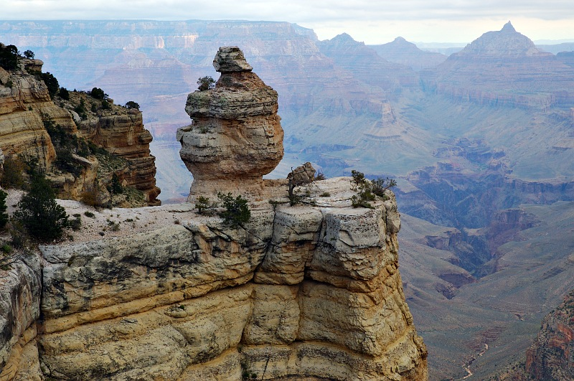
Grand Canyon Hoodoo
Notes:
Hoodoos are unique in having variable width, not to mention a really cool name. But what about that giant canyon? Why did such a massive canyon form here?

Slide 17
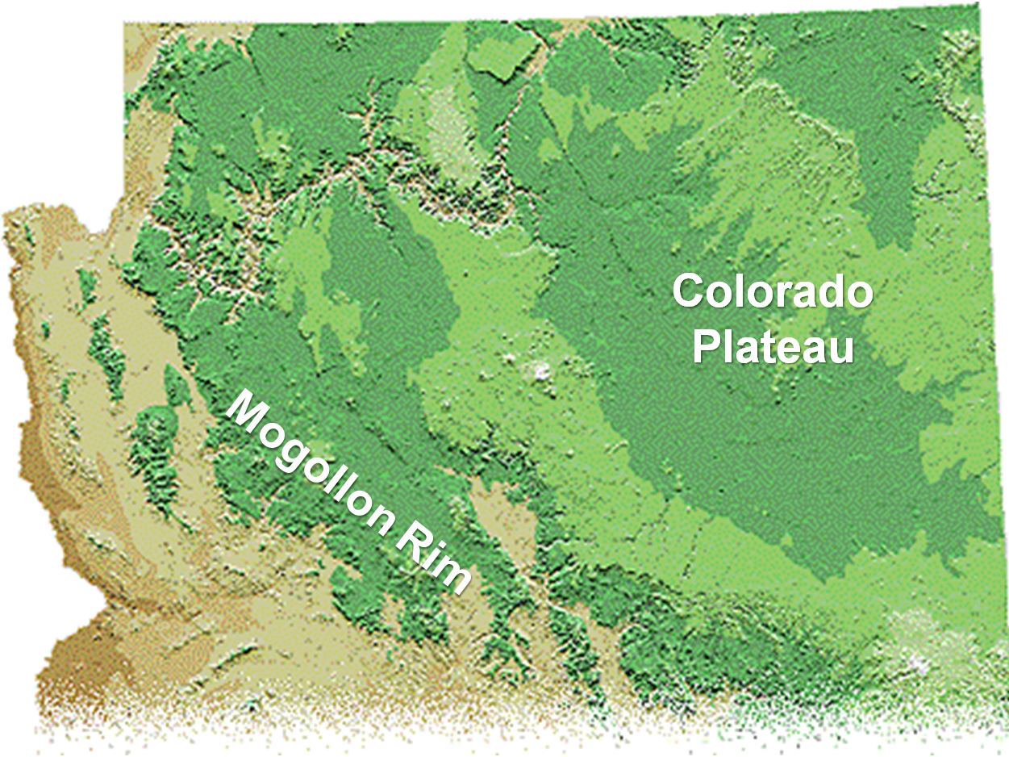
Notes:
Let’s zoom out and look at the large scale situation. First, notice that the Grand Canyon has been eroded into the edge of the Colorado Plateau where stream gradients are steepest and therefore erosion greatest. But steep gradients occur along the entire Mogollon Rim – why did the canyon form in this part?

Slide 18
Green River
Colorado River
San Juan River
Little Colorado River
Notes:
The simple answer is that that’s were all the water is. Note that the Grand Canyon occurs just downstream of the confluence of the Little Colorado, the last major tributary to join the Colorado River. So the Grand Canyon occurs where the Colorado River pretty much has reached its maximum discharge. But this may not always have been the case.

Slide 19
Notes:
One theory for the origin of the Grand Canyon involves stream capture of the Little Colorado River. The idea here is that the Ancestral Upper Colorado River did not connect with the Lower Colorado originally. Where the Upper Colorado flowed to is not clear, …

Slide 20
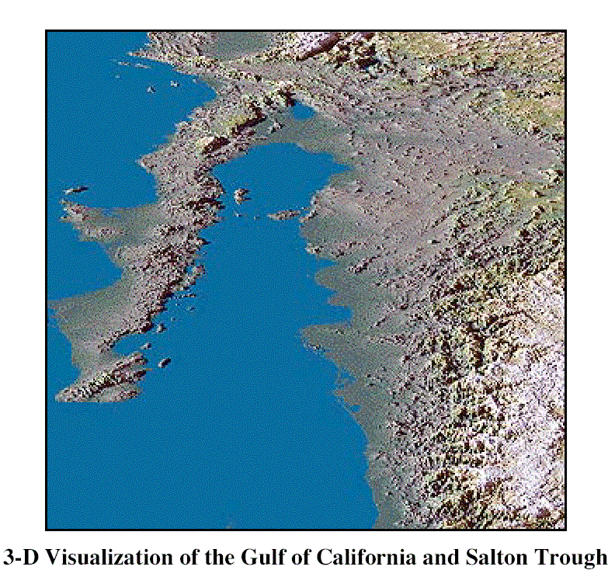
Notes:
… but as the Gulf of California opened, the gradient of nearby streams steepened because they had less distance to travel to get to sea level. Higher gradient led to accelerated stream erosion for streams draining into the newly formed Gulf.

Slide 21
Notes:
Headward erosion on one of these streams, shown here as the Hualapai Drainage System (but ultimately becoming the Lower Colorado), eventually progressed until it reached the Ancestral Upper Colorado. At that point, not only did the upstream portion of the Ancestral Upper Colorado add its water to the Lower Colorado, but continued headward erosion ultimately caused the downstream portion of the Ancestral Upper Colorado to flow towards the Lower Colorado as well.

Slide 22
Notes:
With the now fully integrated drainage systems, far more water flowed through the Grand Canyon causing the tremendous erosion rates required for the formation of the Grand Canyon we see today. Well that’s one theory anyway.

Slide 23
Green River
Colorado River
San Juan River
Little Colorado River
Notes:
There are others that say that the entire Colorado River drainage system was fully integrated before the uplift of the Colorado Plateau and what really got the erosion going in the Grand Canyon was a dramatic increase in stream gradient created by the uplift of the Colorado Plateau combined with the opening of the Gulf of California. Uplift in the Rocky Mountains may also have played a role by increasing precipitation rates in the Colorado River’s headwaters.

Slide 24
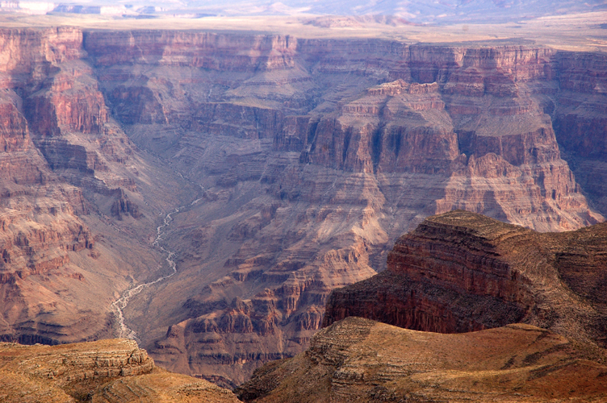
Notes:
No matter how the canyon was carved, all that eroded rock had to go somewhere.

Slide 25
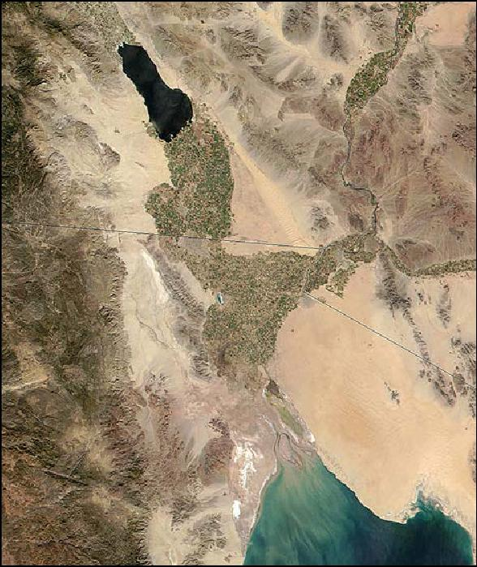
Colorado River Delta
Notes:
Until recently, most researchers pointed to the delta of the Colorado River as the place where the all the eroded rock in the Grand Canyon was deposited. Indeed, gravel derived from the Grand Canyon is found at the base of the delta and that gravel has long been used to date the initial erosion of the canyon at about 6 million years ago.

Slide 26
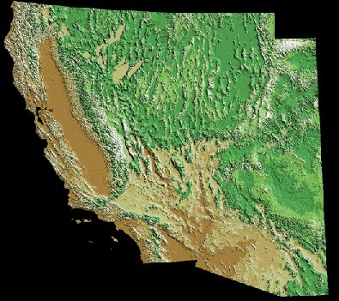
Basin and Range
16-17 mya
Notes:
Recent research rather convincingly indicates that canyon erosion began 16-17 million years ago when the Basin and Range opened. Thus the earliest Colorado River deposits would not have come to rest in the delta at the head of the Gulf of California, but probably deposited somewhere in the Basin and Range.

Slide 27
Basin and Range
10 mya
Notes:
Around 10 million years ago, the Gulf of California opened and streams began draining towards it.

Slide 28
Basin and Range
8 mya
Notes:
Headward erosion lengthened these …

Slide 29
Basin and Range
6 mya
Notes:
… until at about 6 million years ago, one of them connected with the ancestral Colorado and diverted all its flow towards the lower base level in the Gulf of California.

Slide 30
Act 1
INITIAL OROGENY
Notes:
Now that we have a general idea of how the canyon formed, let’s take a closer look at what the exposed rocks there tell us about the past.

Slide 31
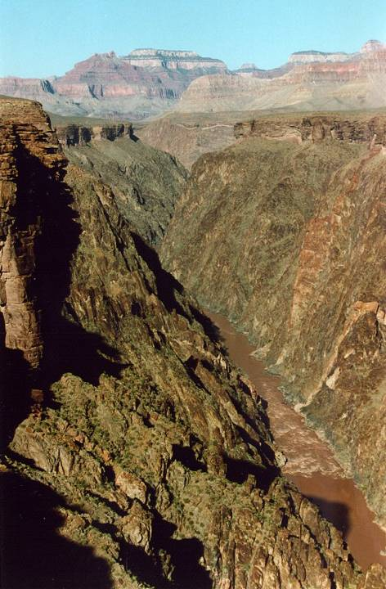
Tonto Platform
Notes:
The oldest rocks are exposed in the deepest part of the canyon, below a well-defined horizontal surface called the Tonto Platform.

Slide 32
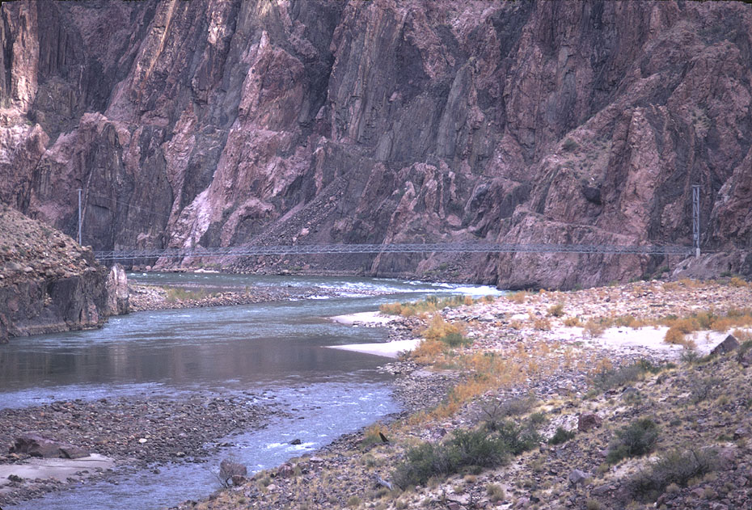
Vishnu Schist
Notes:
The dominant rock unit here is the 1.7 to 1.8 billion-year old Vishnu Schist…

Slide 33
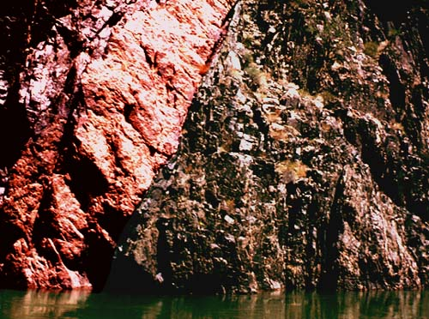
Zoroaster Granite
Vishnu Schist
Notes:
… which is intruded by the slightly younger Zoroaster Granite.

Slide 34
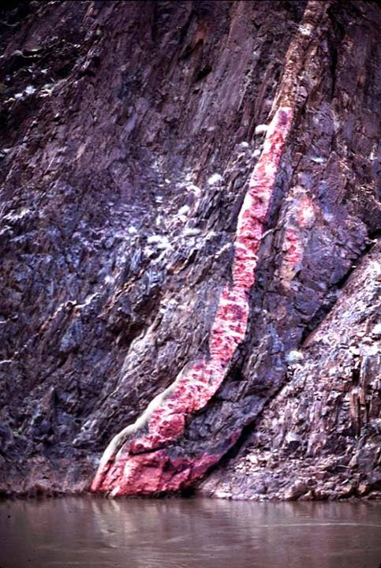
Vishnu Schist
Zoroaster Granite
Notes:
Detailed analysis of these units indicates that ….

Slide 35
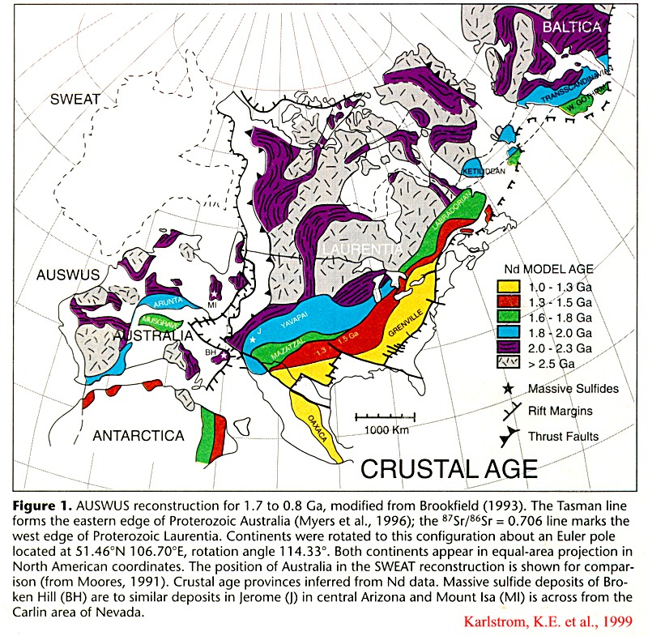
Orogeny
Notes:
… they were formed by a complex series of mountain-building events that took place along the southern margin of Laurentia.

Slide 36
Island arc
Island arc
Micro-continents
Notes:
During these orogenies several different island arc systems and micro-continents collided, and smashed together the ocean sediments lying between them …

Slide 37
schist
gneiss
magma
Notes:
… into mountain ranges that where intruded by subduction-generated magma and metamorphosed into mostly schist and gneiss.

Slide 38
enlargement
Notes:
As uplift continued, more of the igneous and metamorphic rocks of the mountains’ roots were exposed.

Slide 39
enlargement
500 my
peneplain
Notes:
A long erosional period of perhaps 500 million years eventually leveled the region to a vast peneplain.

Slide 40
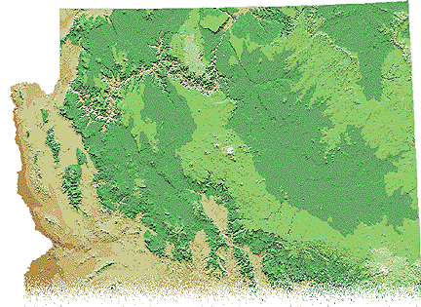
Colorado Plateau
Mogollon Rim
Notes:
Let’s zoom out and look at the large scale situation. First, notice that the Grand Canyon has been eroded into the edge of the Colorado Plateau where stream gradients are steepest and therefore erosion greatest. But steep gradients occur along the entire Mogollon Rim – why did the canyon form in this part?

